Slide 1

Linear Regression Review
Michigan Hackers Machine Learning Team

Slide 2
Agenda
Icebreaker
Review
Vector Equation of a Line
Cost Function and Gradient
Gradient Descent in Python
Implement GD
Work and Ask Questions

Slide 3
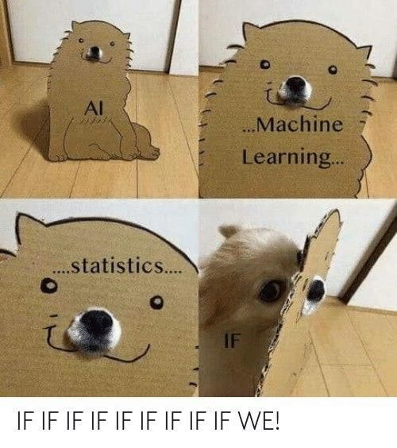
Ice Breaker
Breakout into smaller groups and discuss the difference between machine learning, artificial intelligence, and data science.

Slide 4
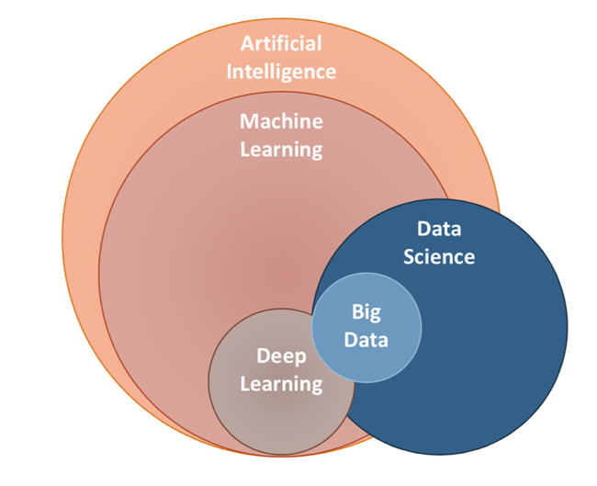

Slide 5
Review

Slide 6
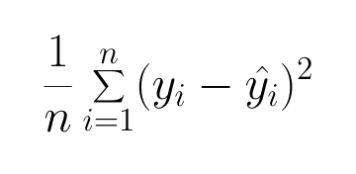
Mean Squared Error (MSE)
Idea: Punish large error even more. Make all errors positive so that you can minimize.

Slide 7
Linear Regression with MSE
Goal of Linear Regression with MSE: Given labeled training data, learn a linear function with the lowest MSE.
This is an optimization problem.

Slide 8
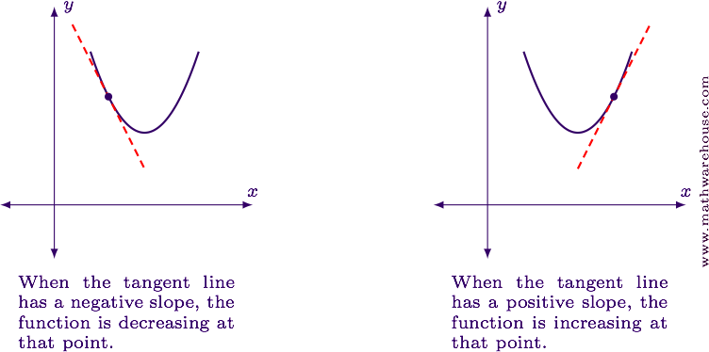
Gradient Descent (GD)
Gradient descent is a method for solving optimization problems.
Taking the gradient of a function at a point gives you the slope at that point.
Gradient is just like first derivative but can be applied in any dimension.

Slide 9
Gradient Descent (GD)
Idea: Start with a random point on a graph. Iteratively move in the opposite direction of the gradient of that point. Stop when your point doesn’t move much.
Step size is a parameter which determines how far your point moves at each iteration. This is also called the learning rate.

Slide 10
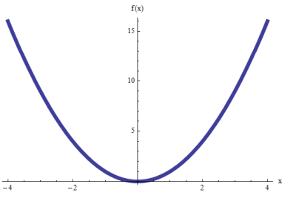
Linear Regression with MSE using GD
Given a labeled set of data, find a line of best fit by minimizing mean squared error (MSE) using gradient descent (GD).

Slide 11
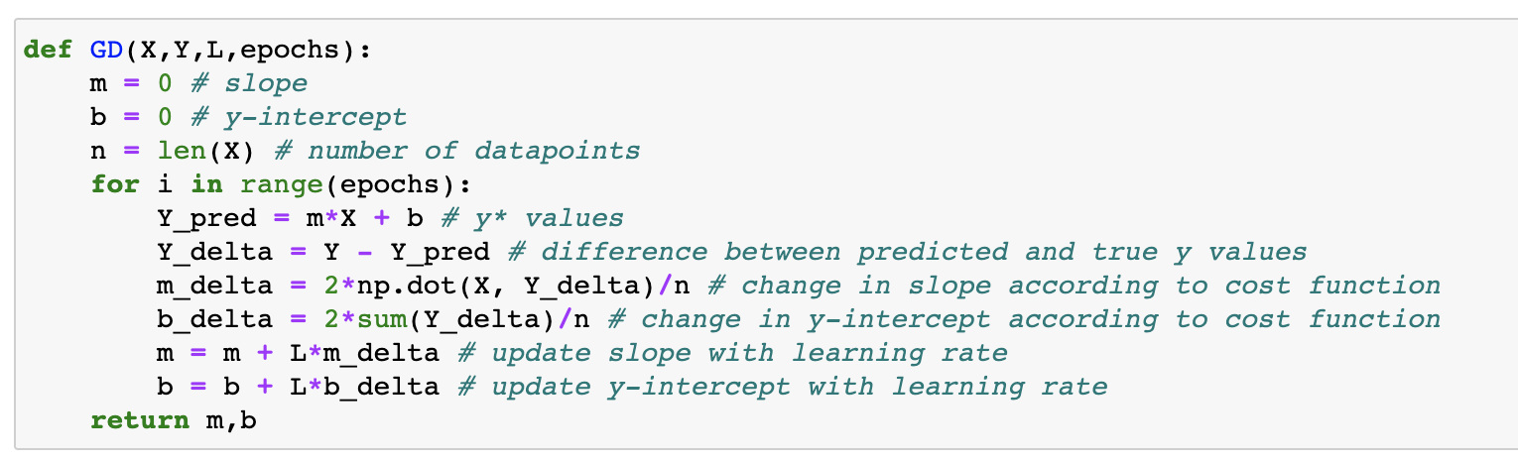
Recall

Slide 12
Vector Equation of a Line

Slide 13







Vector Equation of a Line
Recall the standard form of a line:
Consider the following vectors:
Consider this equation:

Slide 14

Vector Equation of a Line
Thus, is the equation of a line.
Notice that finding the line of best fit is equivalent to finding the value of which minimizes error.

Slide 15
Cost Function

Slide 16
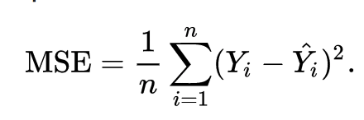
Mean Squared Error

Slide 17
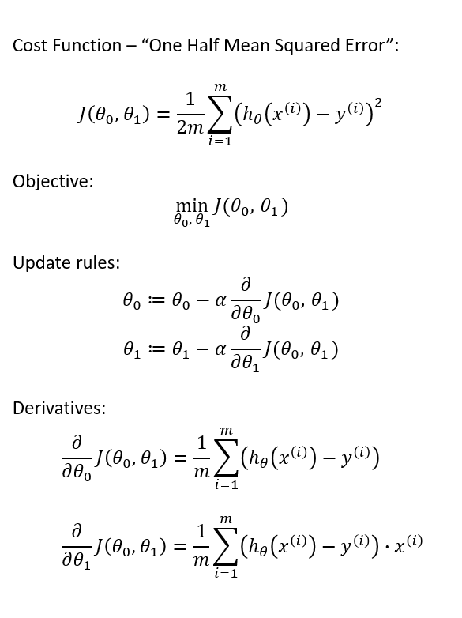
Gradient
Of Half Mean Squared Error

Slide 18
Gradient Descent in Python

Slide 19
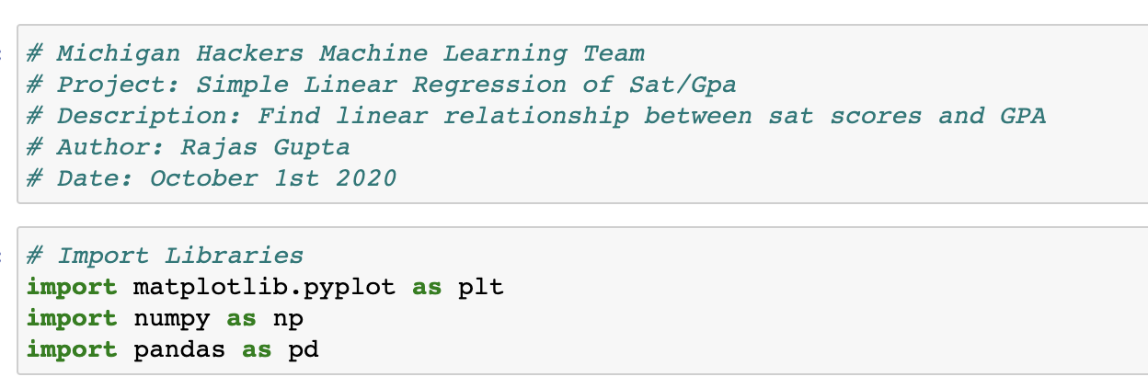
Setting Up

Slide 20
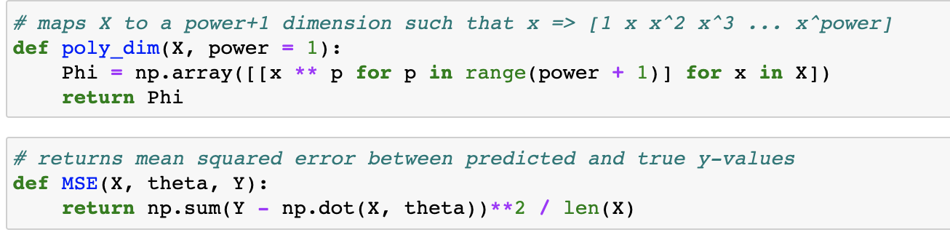
Helper Functions

Slide 21
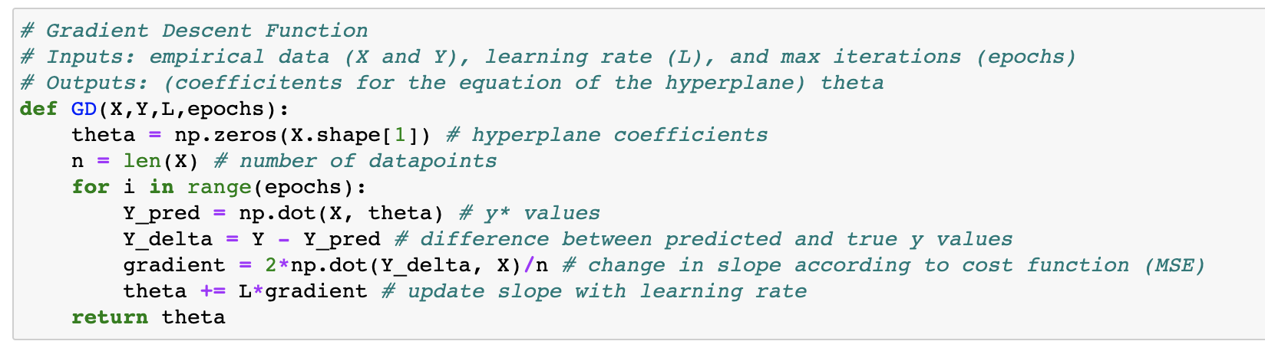
Gradient Descent Algorithm

Slide 22
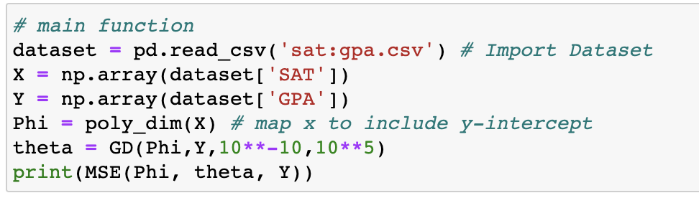
Main Function

Slide 23
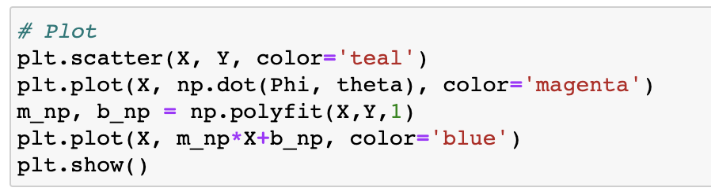
Plot Function

Slide 24
Try on your own!

Slide 25
Work and Ask Questions
Questions about any topic, onboarding, or computer setup
Please try to finish implementing gradient descent for linear regression in Python by next week. Upload your jupyter notebook to the google drive.

Slide 26

Thank You!
Michigan Hackers Machine Learning Team
Contact Info:
Rajas Gupta | rajasg@umich.edu
Vijay Shamra | vsharm@umich.edu
Provide Feedback

